Slide 1

Emergency Evacuation Procedures
Reggie Long
r3long@ucsd.edu
2015

Slide 2
Definition of Roles
Incident Commander – Senior Security person at time of alarm. Directs security team to ensure safe evacuation of the building, communicates issues to information officer for dissemination to Area Safety Coordinators.
Security Personnel – Primary responsibility is to sweep building during an evacuation to identify persons unable or unwilling to exit.
Information Officer – The person responsible for the exchange of information between the Incident Commander and Area Safety Coordinators.
Area Safety Coordinators – This person is responsible for taking account of lab personnel and reporting to the Information Officer if everyone is or is not accounted for.
Building Occupants – Anyone not identified in the above roles is responsible for exiting the building to the designated evacuation area where they will check in with their Area Safety Coordinator.

Slide 3
Emergency Response Structure
Incident Commander
Security
Information Officer
EH&S
Facility Manager
*May assume Incident Commander Role or assist Information Officer.
Area Safety Coord.
Area Safety Coord.
Area Safety Coord.
Area Safety Coord.
Area Safety Coord.
Area Safety Coord.
Area Safety Coord.
Area Safety Coord.
Area Safety Coord.
To make sure that information moves properly in both directions, all individuals in red rectangles on the above will be connected via hand held radios. This ensures that information can easily be transmitted among all persons. It is preferred that information first be passed to the Information Officer, so they can determine if there is a need to forward this along to the rest of the group.
* Depending on the nature of the emergency.

Slide 4
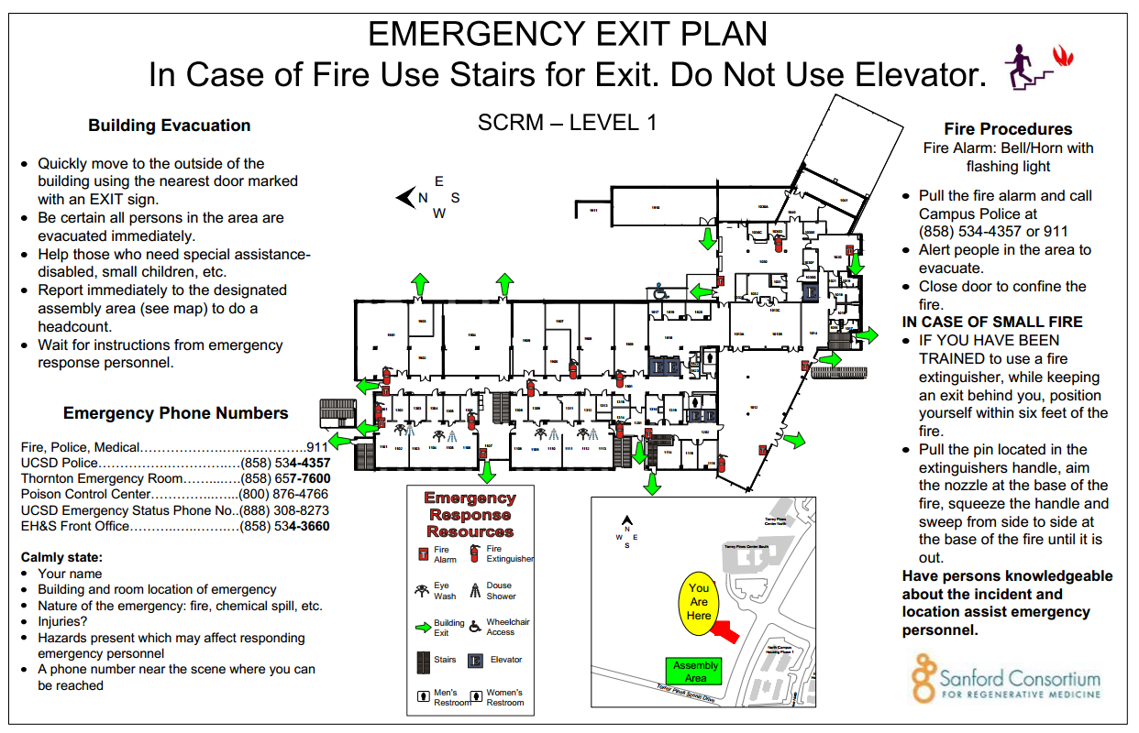
Evacuating the building
Whenever a building alarm sounds, all persons must evacuate the building. Leave the building using a designated evacuation route. Routes out of the building should be identified prior to an emergency. Maps showing these routes are located throughout the building, near elevators and stairwells.

Slide 5
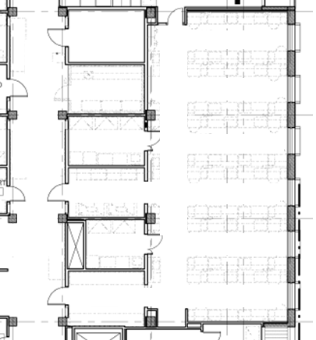
Safe Exiting
Exit routes have code minimum widths to accommodate occupancy loads:
Corridor – not less than 44 inches.
Public access aisle – not less than 36 inches
Non-public access aisle – not less than 28 inches
These widths will be reviewed during building inspections/audits. Equipment or other items impeding these minimums will have to be moved.

Slide 6
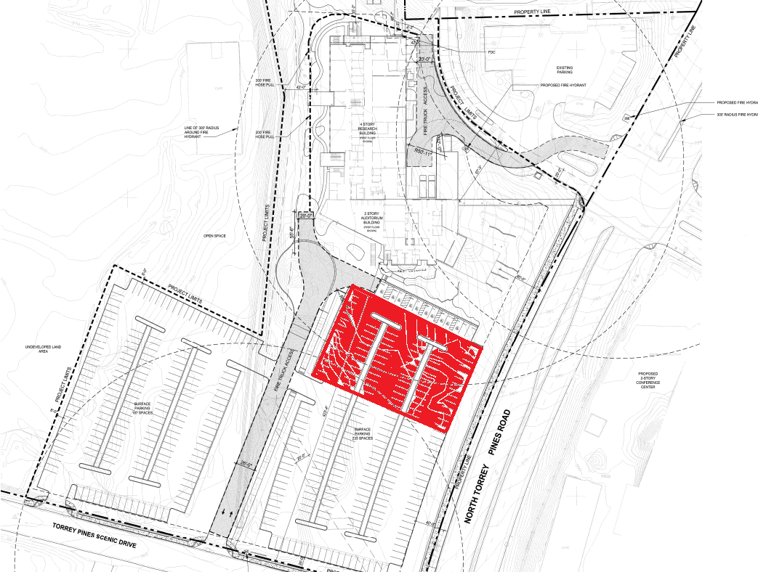
Once out of the building, head to the designated evacuation area. At this time that area is located at the north end of the east parking lot as illustrated below. Once in this location, attempt to make contact with you Area Safety Coordinator if you have not already done so. Do not leave the assembly area for any reason unless instructed to do so by the Information Officer.
N

Slide 7
Accounting for Personnel
Once assembled at the Evacuation Area, each lab should take account of their personnel.
After a reasonable amount of time, the Area Safety Coordinator should report to the Information Officer if all persons are present, or if individuals are missing.
It is critical that no one re-enters the building or leaves the Evacuation Area until the Information Officer or Incident Commander has cleared the building.

